Slide 1

Psychological Therapies
Chapter 15

Slide 2
Chapter 15 Learning Objective Menu
LO 15.1 Two ways to treat psychological disorders
LO 15.2 How psychological disorders treated in past
LO 15.3 Basic elements of Freud’s psychoanalysis
LO 15.4 Psychoanalysis today
LO 15.5 Basic elements of Roger’s person-centered therapy
LO 15.6 Gestalt therapy
LO 15.7 Humanistic therapy today
LO 15.8 Behavior therapists’ use of classical conditioning
LO 15.9 Behavior therapists’ use of operant conditioning
LO 15.10 Success of behavior therapies
LO 15.11 Cognitive therapy
LO 15.12 Goals of cognitive-behavioral therapies
LO 15.13 Rational-emotive therapy
LO 15.14 Success of cognitive and cognitive-behavior therapies
LO 15.15 Group therapy
LO 15.16 Types of group therapy
LO 15.17 When group therapy is most useful
LO 15.18 Eye-movement desensitization reprocessing
LO 15.19 Effectiveness of psychotherapy
LO 15.20 Cultural, ethnic, or gender differences in effectiveness
LO 15.21 Types of drugs used to treat psychological disorders
LO 15.22 Electroconvulsive therapy
LO 15.23 Psychosurgery
LO 15.24 Dangers of treating children and adolescent with antidepressants

Slide 3
Therapy
LO 15.1 Two ways to treat psychological disorders
Therapy - treatment methods aimed at making people feel better and function more effectively.
Psychotherapy - therapy for mental disorders in which a person with a problem talks with a psychological professional.
  Insight therapies - psychotherapies in which the main goal is helping people to gain insight with respect to their behavior, thoughts, and feelings.
  Action therapy - psychotherapy in which the main goal is to change disordered or inappropriate behavior directly.
Biomedical therapy - therapy for mental disorders in which a person with a problem is treated with biological or medical methods to relieve symptoms.
Menu

Slide 4

Treatment in the Past
LO 15.2 How psychological disorders treated in past
Mentally ill people began to be confined to institutions called asylums in the mid-1500s.
Treatments were harsh and often damaging.
Philippe Pinel became famous for demanding that the mentally ill be treated with kindness, personally unlocking the chains of inmates in France.
Menu

Slide 5
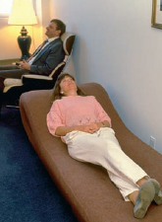
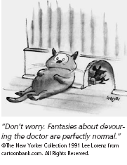
Freud’s Psychoanalysis
LO 15.3 Basic elements of Freud’s psychoanalysis
Psychoanalysis - an insight therapy based on the theory of Freud, emphasizing the revealing of unconscious conflicts.
  Dream interpretation
    Manifest content – the actual content of one’s dream.
    Latent content – the symbolic or hidden meaning of dreams.
  Free association – Freudian technique in which a patient was encouraged to talk about anything that came to mind without fear of negative evaluations.
Menu

Slide 6
Freud’s Psychoanalysis
LO 15.3 Basic elements of Freud’s psychoanalysis
Resistance - occurring when a patient becomes reluctant to talk about a certain topic, either changing the subject or becoming silent.
Transference - in psychoanalysis, the tendency for a patient or client to project positive or negative feelings for important people from the past onto the therapist.
Menu

Slide 7
Psychoanalysis Today
LO 15.4 Psychoanalysis today
Psychodynamic therapy - a newer and more general term for therapies based on psychoanalysis, with an emphasis on transference, shorter treatment times, and a more direct therapeutic approach.
Nondirective - therapy style in which the therapist remains relatively neutral and does not interpret or take direct actions with regard to the client, instead remaining a calm, nonjudgmental listener while the client talks.
Directive - therapy in which the therapist actively gives interpretations of a client’s statements and may suggest certain behavior or actions. Psychoanalysis today is more directive.
Menu

Slide 8
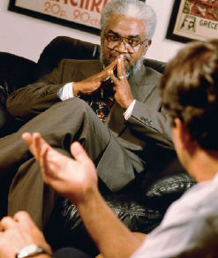
Roger’s Person-Centered Therapy
LO 15.5 Basic elements of Roger’s person-centered therapy
Person-centered therapy - a nondirective insight therapy based on the work of Carl Rogers in which the client does all the talking and the therapist listens.
Four Elements:
  Reflection - therapy technique in which the therapist restates what the client says rather than interpreting those statements.
  Unconditional positive regard - referring to the warmth, respect, and accepting atmosphere created by the therapist for the client in person-centered therapy.
  Empathy - the ability of the therapist to understand the feelings of the client.
  Authenticity - the genuine, open, and honest response of the therapist to the client.
Menu

Slide 9
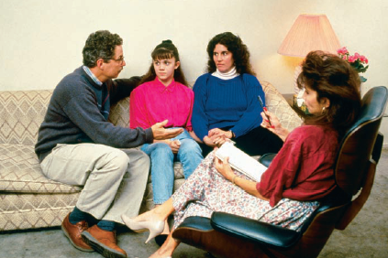
Gestalt Therapy
LO 15.6 Gestalt therapy
Gestalt therapy - form of directive insight therapy in which the therapist helps clients to accept all parts of their feelings and subjective experiences, using leading questions and planned experiences such as role-playing.
Try to help clients deal with things in their past that they have denied and will use body language and other nonverbal cues to understand what clients are really saying.
Menu

Slide 10
Today’s View of Humanistic Therapy
LO 15.7 Humanistic therapy today
Humanistic therapies are not based in experimental research and work best with intelligent, highly verbal persons.
Menu

Slide 11
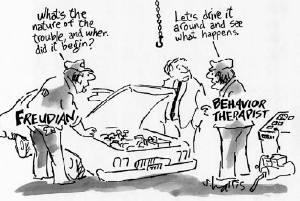
Behavioral Therapy and Classical Conditioning
LO 15.8 Behavior therapists’ use of classical conditioning
Behavior therapies - action therapies based on the principles of classical and operant conditioning and aimed at changing disordered behavior without concern for the original causes of such behavior.
Behavior modification or applied behavior analysis – the use of learning techniques to modify or change undesirable behavior and increase desirable behavior.
Menu

Slide 12
Behavioral Therapy and Classical Conditioning
LO 15.8 Behavior therapists’ use of classical conditioning
Systematic desensitization - behavior technique used to treat phobias, in which a client is asked to make a list of ordered fears and taught to relax while concentrating on those fears.
  Counterconditioning - replacing an old conditioned response with a new one by changing the unconditioned stimulus.
Menu

Slide 13
Behavioral Therapy and Classical Conditioning
LO 15.8 Behavior therapists’ use of classical conditioning
Aversion therapy - form of behavioral therapy in which an undesirable behavior is paired with an aversive stimulus to reduce the frequency of the behavior.
Flooding - technique for treating phobias and other stress disorders in which the person is rapidly and intensely exposed to the fear-provoking situation or object and prevented from making the usual avoidance or escape response.
Menu

Slide 14
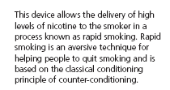
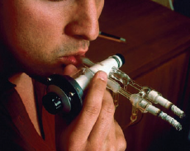
LO 15.8 Behavior therapists’ use of classical conditioning
Menu

Slide 15
Behavioral Therapy and Operant Conditioning
LO 15.9 Behavior therapists’ use of operant conditioning
Modeling - learning through the observation and imitation of others.
  Participant modeling - technique in which a model demonstrates the desired behavior in a step-by-step, gradual process while the client is encouraged to imitate the model.
Reinforcement - the strengthening of a response by following it with a pleasurable consequence or the removal of an unpleasant stimulus.
Menu

Slide 16
Behavioral Therapy and Operant Conditioning
LO 15.9 Behavior therapists’ use of operant conditioning
  Token economy - the use of objects called tokens to reinforce behavior in which the tokens can be accumulated and exchanged for desired items or privileges.
  Contingency contract – a formal, written agreement between the therapist and client (or teacher and student) in which goals for behavioral change, reinforcements, and penalties are clearly stated.
Menu

Slide 17
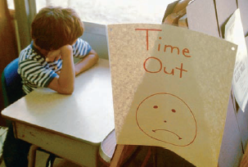
Behavioral Therapy and Operant Conditioning
LO 15.9 Behavior therapists’ use of operant conditioning
Extinction – the removal of a reinforcer to reduce the frequency of a behavior.
  Time-out - an extinction process in which a person is removed from the situation that provides reinforcement for undesirable behavior, usually by being placed in a quiet corner or room away from possible attention and reinforcement opportunities.
Menu

Slide 18
Effectiveness of Behavioral Therapy
LO 15.10 Success of behavior therapies
Behavior therapies can be effective in treating specific problems, such as bedwetting, drug addictions, and phobias.
Can help improve some of the more troubling behavioral symptoms associated with more severe disorders.
Menu

Slide 19
Cognitive Therapy
LO 15.11 Cognitive therapy
Cognitive therapy - therapy in which the focus is on helping clients recognize distortions in their thinking and replace distorted, unrealistic beliefs with more realistic, helpful thoughts.
Cognitive Distortions based on Beck’s Cognitive Therapy:
  Arbitrary inference – distortion of thinking in which a person draws a conclusion that is not based on any evidence.
  Selective thinking - distortion of thinking in which a person focuses on only one aspect of a situation while ignoring all other relevant aspects.
Menu

Slide 20
Cognitive Therapy
LO 15.11 Cognitive therapy
Cognitive Distortions:
  Overgeneralization - distortion of thinking in which a person draws sweeping conclusions based on only one incident or event and applies those conclusions to events that are unrelated to the original.
  Magnification and minimization - distortions of thinking in which a person blows a negative event out of proportion to its importance (magnification) while ignoring relevant positive events (minimization).
  Personalization - distortion of thinking in which a person takes responsibility or blame for events that are unconnected to the person.
Menu

Slide 21
Cognitive-Behavioral Therapies
LO 15.12 Goals of cognitive-behavioral therapies
Cognitive-behavioral therapy (CBT) - action therapy in which the goal is to help clients overcome problems by learning to think more rationally and logically.
Three goals:
  Relieve the symptoms and solve the problems.
  To develop strategies for solving future problems.
  To help change irrational, distorted thinking.
Menu

Slide 22
Rational-Emotive Therapy
LO 15.13 Rational-emotive therapy
Rational-emotive behavior therapy (REBT) - cognitive-behavioral therapy in which clients are directly challenged in their irrational beliefs and helped to restructure their thinking into more rational belief statements.
Menu

Slide 23
Success of CBT
LO 15.14 Success of cognitive and cognitive-behavior therapies
CBT has seemed successful in treating depression, stress disorders, and anxiety.
Criticized for focusing on the symptoms and not the causes of disordered behavior.
Menu

Slide 24
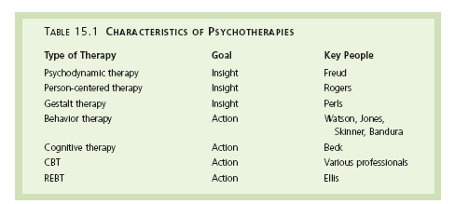
LO 15.
Menu

Slide 25
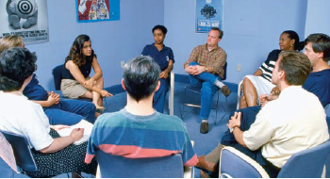
Group Therapy
LO 15.15 Group therapy
Advantages:
  Low cost.
  Exposure to other people with similar problems, social interaction with others.
  Social and emotional support from people with similar disorders or problems.
Menu

Slide 26
Group Therapy
LO 15.15 Group therapy
Disadvantages:
  Need to share the therapist’s time with others in the group.
  Lack of a private setting in which to reveal concerns.
  Possibility that shy people will not be able to speak up within a group setting.
  Inability of people with severe disorders to tolerate being in a group.
Menu

Slide 27
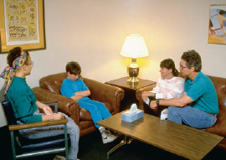
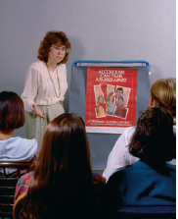
Types of Group Therapy
LO 15.16 Types of group therapy
Family counseling (family therapy) - a form of group therapy in which family members meet together with a counselor or therapist to resolve problems that affect the entire family.
Self-help groups (support groups) - a group composed of people who have similar problems and who meet together without a therapist or counselor for the purpose of discussion, problem solving, and social and emotional support.
Menu

Slide 28
When is Group Therapy Useful?
LO 15.17 When group therapy is most useful
Group therapy is most useful to persons who cannot afford individual therapy and who may obtain a great deal of social and emotional support from other group members.
Menu

Slide 29
Eye Movement Desensitization Reprocessing
LO 15.18 Eye-movement desensitization reprocessing
Eye-movement desensitization reprocessing (EMDR) – controversial form of therapy for posttraumatic stress disorder and similar anxiety problems in which the client is directed to move the eyes rapidly back and forth while thinking of a disturbing memory.
Need more controlled studies.
Menu

Slide 30
Effectiveness of Psychotherapy
LO 15.19 Effectiveness of psychotherapy
Psychotherapy is more effective than no treatment at all.
From 75 to 90 percent of people who receive therapy improve, the longer a person stays in therapy the better the improvement, and psychotherapy works as well alone as with drugs.
Some types of psychotherapy are more effective for certain types of problems, and no one psychotherapy method is effective for all problems.
  Effective therapy should be matched to the particular client and the particular problem,
Menu

Slide 31
Effectiveness of Psychotherapy
LO 15.19 Effectiveness of psychotherapy
Eclectic therapies - therapy style that results from combining elements of several different therapy techniques.
Therapeutic alliance - the relationship between therapist and client that develops as a warm, caring, accepting relationship characterized by empathy, mutual respect, and understanding.
Menu

Slide 32
Culture and Psychotherapy
LO 15.20 Cultural, ethnic, or gender differences in effectiveness
When the culture, ethnic group, or gender of the therapist and the client differs, misunderstandings and misinterpretations can occur.
Four barriers to effective psychotherapy that exist when the backgrounds of client and therapist differ are language, cultural values, social class, and nonverbal communication.
Menu

Slide 33
Cybertherapy
LO 15.20 Cultural, ethnic, or gender differences in effectiveness
Cybertherapy - psychotherapy that is offered on the Internet. Also called online, Internet, or Web therapy or counseling.
  Offers the advantages of anonymity and therapy for people who cannot otherwise get to a therapist.
Menu

Slide 34
Drug Treatments
LO 15.21 Types of drugs used to treat psychological disorders
Biomedical therapies – therapies that directly affect the biological functioning of the body and brain.
Psychopharmacology - the use of drugs to control or relieve the symptoms of psychological disorders.
  Antipsychotic drugs - drugs used to treat psychotic symptoms such as delusions, hallucinations, and other bizarre behavior.
Menu

Slide 35
Drug Treatments
LO 15.21 Types of drugs used to treat psychological disorders
  Antianxiety drugs - drugs used to treat and calm anxiety reactions, typically minor tranquilizers.
  Antimanic drugs - used to treat bipolar disorder and include lithium and certain anticonvulsant drugs.
  Antidepressant drugs - drugs used to treat depression and anxiety.
Menu

Slide 36
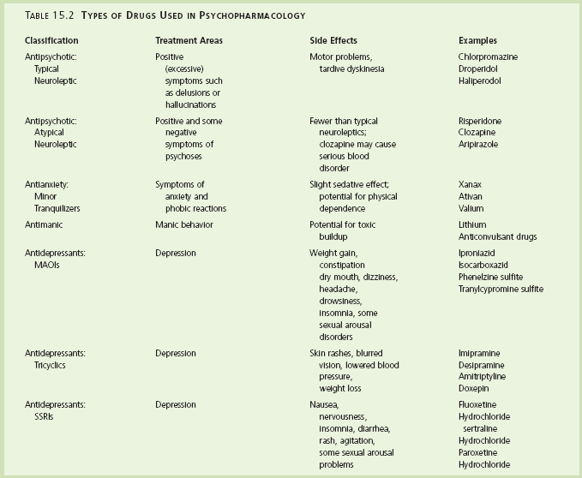
LO 15.21 Types of drugs used to treat psychological disorders
Menu

Slide 37

Electroconvulsive Therapy
LO 15.22 Electroconvulsive therapy
Electroconvulsive therapy (ECT) - form of biomedical therapy to treat severe depression in which electrodes are placed on either one or both sides of a person’s head and an electric current is passed through the electrodes that is strong enough to cause a seizure or convulsion.
  Bilateral ECT - electroconvulsive therapy in which the electrodes are placed on both sides of the head.
  Unilateral ECT - electroconvulsive therapy in which the electrodes are placed on only one side of the head and the forehead.
Menu

Slide 38
Psychosurgery
LO 15.23 Psychosurgery
Psychosurgery - surgery performed on brain tissue to relieve or control severe psychological disorders.
  Prefrontal lobotomy - psychosurgery in which the connections of the prefrontal lobes of the brain to the rear portions are severed.
  Bilateral cingulotomy - psychosurgical technique in which an electrode wire is inserted into the cingulated gyrus area of the brain with the guidance of a magnetic resonance imaging machine for the purpose of destroying that area of brain tissue with an electric current.
Menu

Slide 39
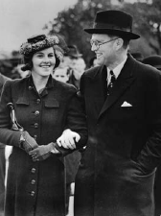
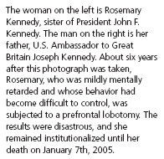
LO 15.23 Psychosurgery
Menu

Slide 40

Danger of Treating Children with Antidepressants
LO 15.24 Dangers of treating children and adolescents with antidepressants
All but one antidepressant drug has been associated with an increased risk of suicide when used to treat depression in children and adolescents.
  Prozac, the one safe antidepressant for children and adolescents, has been found to be more effective when combined with psychotherapy.
Menu

